Slide 1

Climate change in the UK
By :
Erwin Ragulan

Slide 2
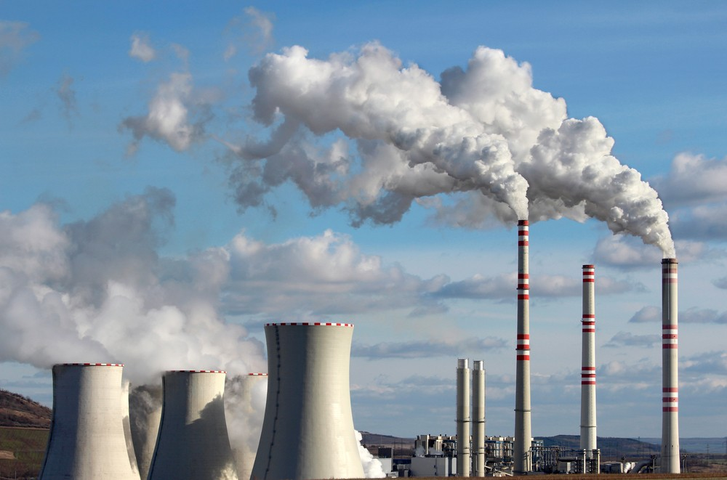
What is Climate change
In a simplified way, climate change is when we humans burn fossil fuel which are released into the atmosphere, preventing gas from leaving the Earth. The gases can’t leave the atmosphere because of greenhouse effect. Greenhouse effect is a consequence of an electromagnetic radiation at most wavelength, which passes through the Earth’s atmosphere.

Slide 3
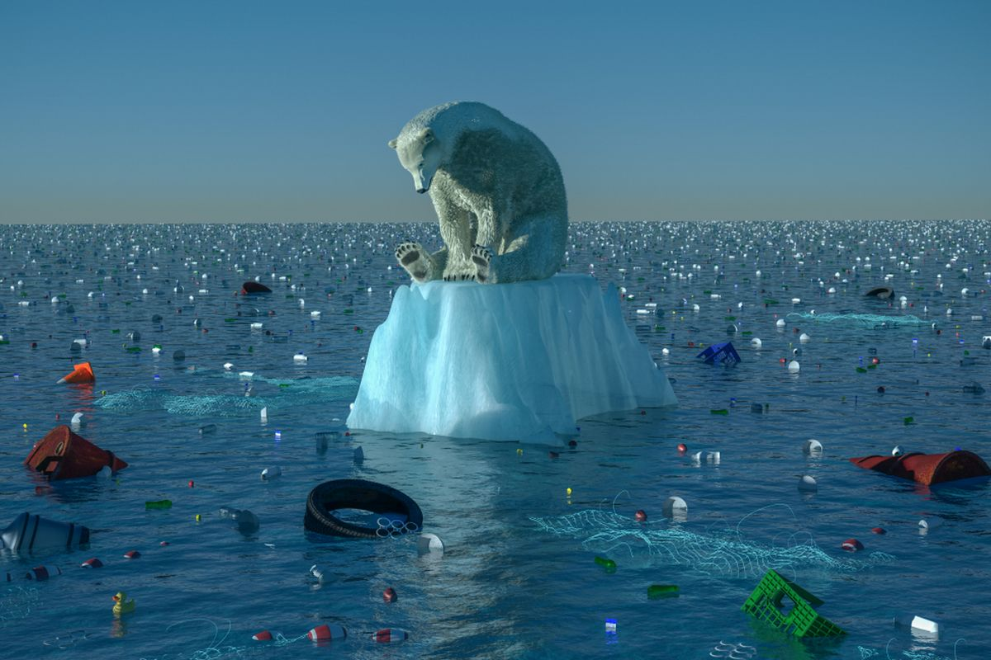
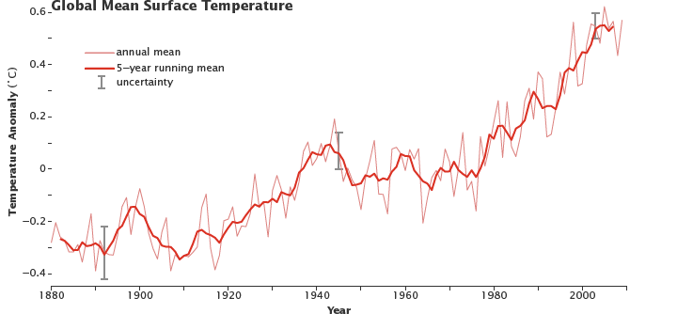
What are the effects ?
1) Extinction of animals affecting food webs
2)Higher chances of natural hazards
3)Lower chances of survival for future generations
4)More than a quarter of the world to be underwater
5)Global temperatures increasing

Slide 4
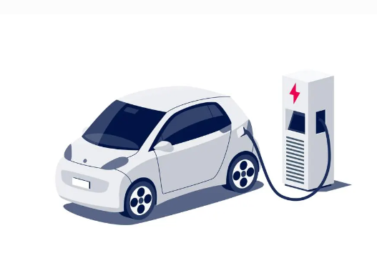
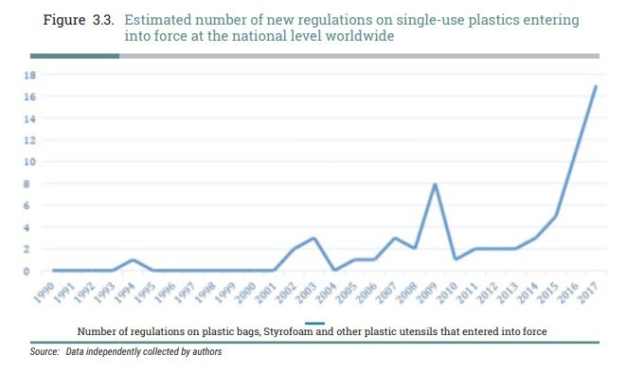
What can we do to prevent it ?
1) We can see the usage of plastic bags has rapidly increased ever since 2010 but after the law was introduced the usage of plastic bags decreased by 86% which is tremendously successful.
2) Using electric cars burns no fossil fuel such as diesel or
petrol, which can help reduce our input towards global
warming.
3) Eating less meat since animal farming is the second biggest
CO2 producer.
4) Using renewable energy

